Slide 1
Drinking Ingredient Catalog
ADS 507 - Practical Data Engineering

Slide 2
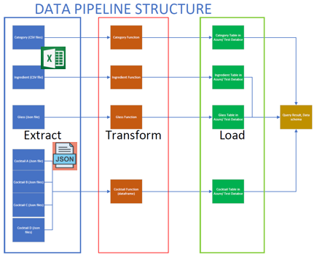
Data Source and Extraction
Sources:
2 CSV files of Category and Ingredient
2 API files of Glass and drinks
Establish Connection to cocktaildb.com API
Extract data
Extract Transform Load (ETL) architect diagram
Notes:
Thank you Muris.
In the next 3 mins, I am going to share how data are ingested, extracted from sources, manipulated and changed according to our objective. At the end, these data will be stored in Azure platform SQL Database .
There are 4 datasets for this project; 2 CSV files and 2 JSON files. It’s originated from cocktaildb.com.
Since CSV data of Category and Ingredients are structure well and don’t have many changes, the data were extracted in batch. While JSON files of Glass Type and list of Drink were extracted by establishing a connection for API integration.

Slide 3
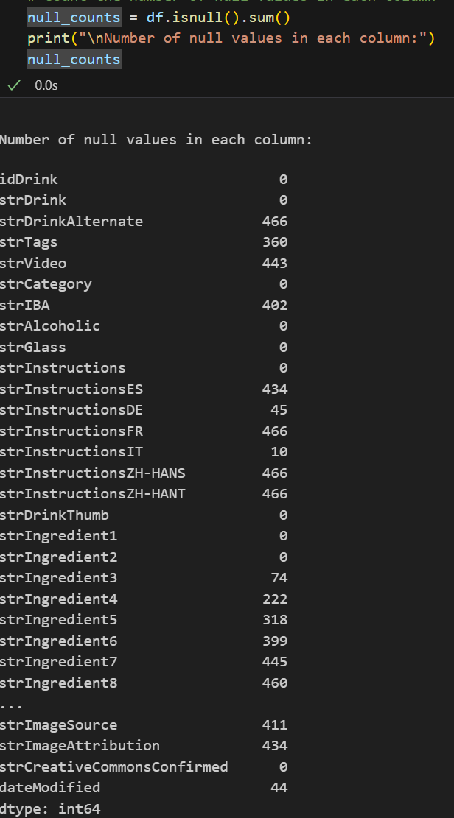
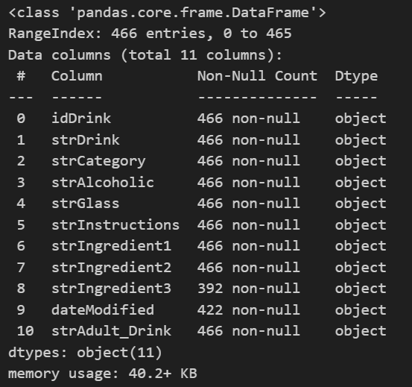
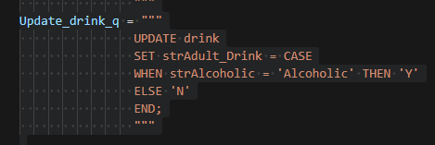
Data Clean up and Transformation
Data Clean up
Columns with Null Values
Drop columns with null values
Drink table attributes to be loaded to SQL DB →
Perform data transformation in SQL
Notes:
Category, Ingredient and Glass Type data have no transformation.
When we explored Drink dataframe, we found some nulls values. These null values in these columns are not significant to the data and project objective. Therefore, these columns will be dropped from dataframe before it’s stored.
Category, Ingredient, Glass Type and cleaned-up Drink dataframes were loaded to SQL database in Azure platform.
A simple transformation was also done in SQL by adding new binary column in Drink Table to identify if it’s adult drink or not. strAdult_Drink attribute in Drink table was updated by cooperating Case Statement.

Slide 4
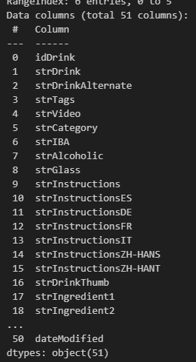
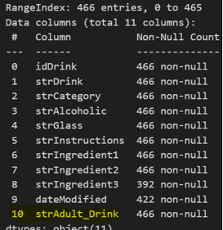
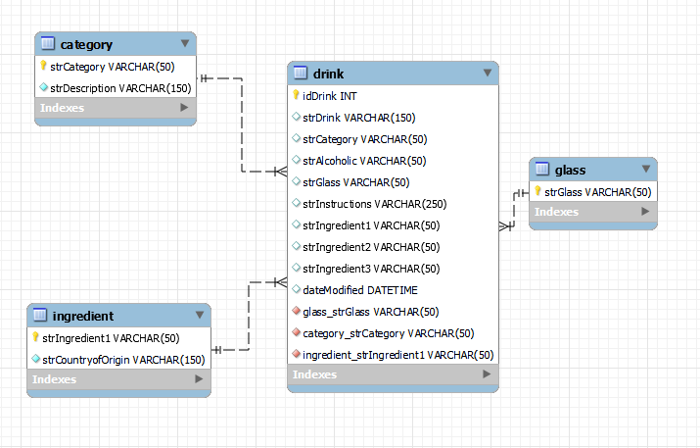
Data Load and Schema
Extracted Dataset
Transformed Dataset
Loaded Datasets – Database Schema
Notes:
After data was cleaned and transformed, we connected to our database to send the transformed data for storage. A database model/ schema was generated by utilizing reverse engineering. The loaded dataset in SQL DB would be use in the future to meet the business purpose.
Marvin will elaborate how the data will be interacted .

